Slide 1
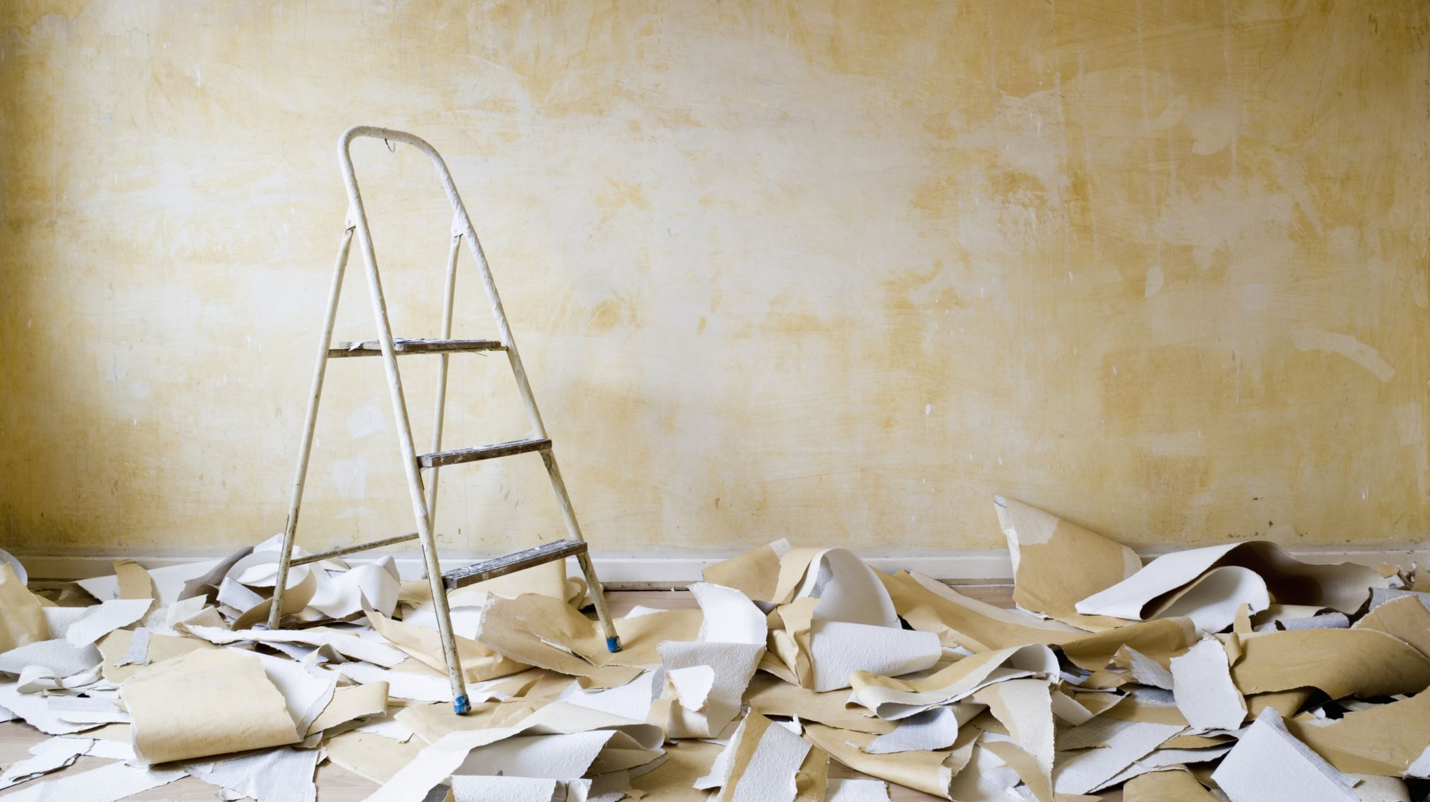
Tom’s Renovations
The road to independence
Autumn 2022

Slide 2
First choosing the colour of the walls!

Slide 3
Preparation of the walls

Slide 4
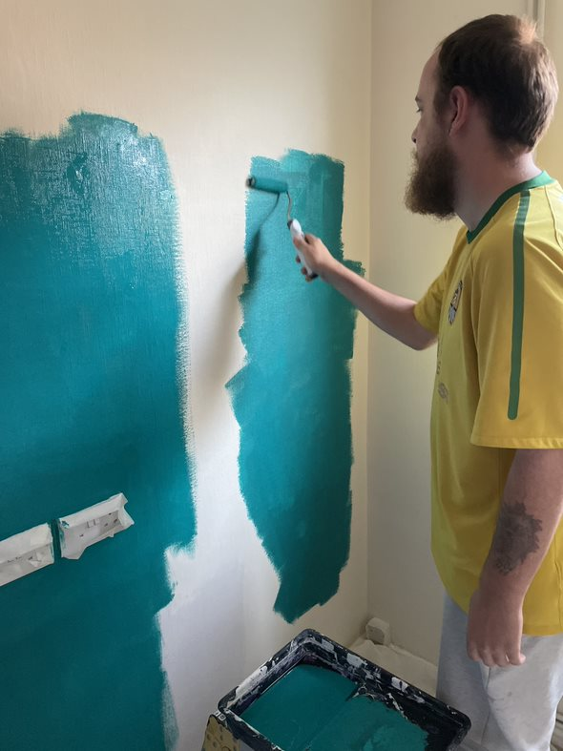
Painting first coat.

Slide 5
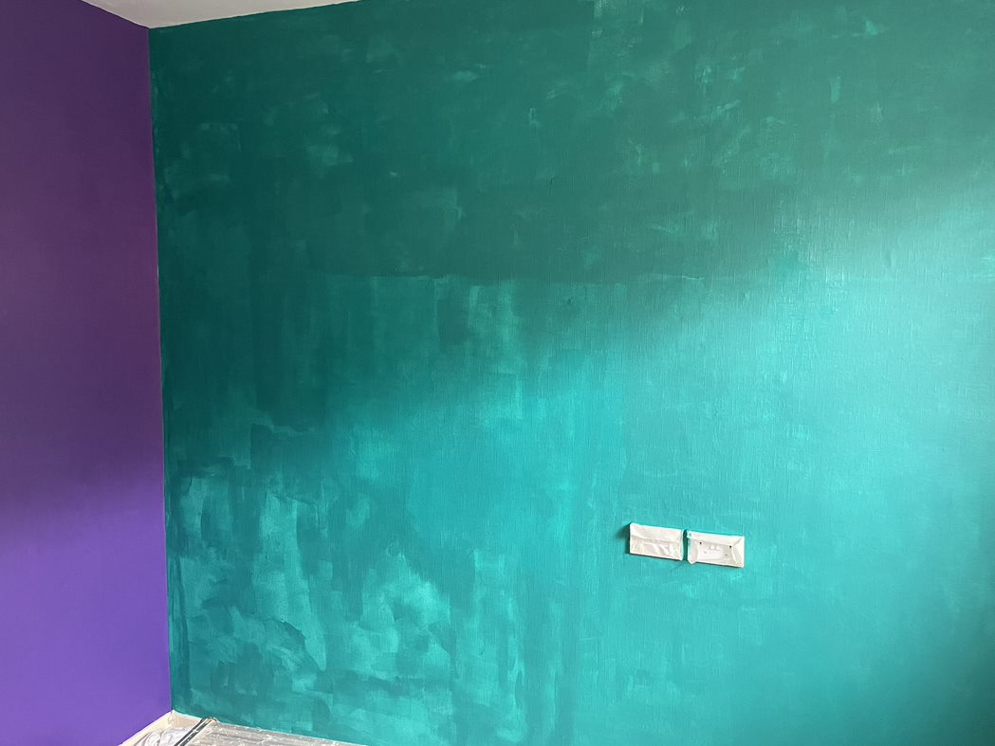
Definitely needs a second coat!

Slide 6
Now for the white walls

Slide 7
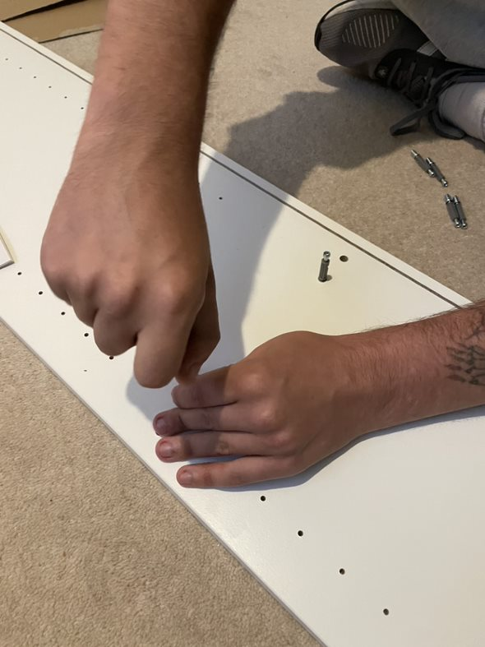
The challenge of the flat pack shelves from IKEA!

Slide 8
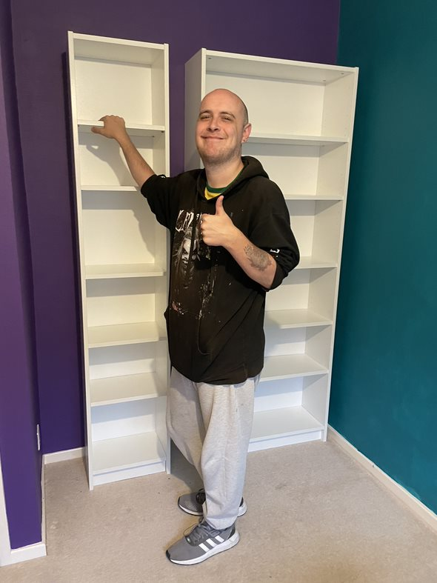
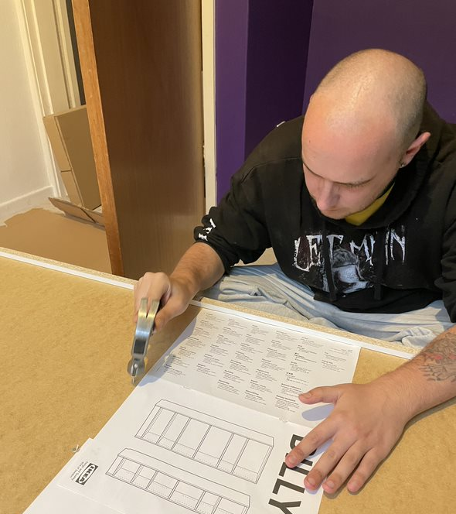

Slide 9
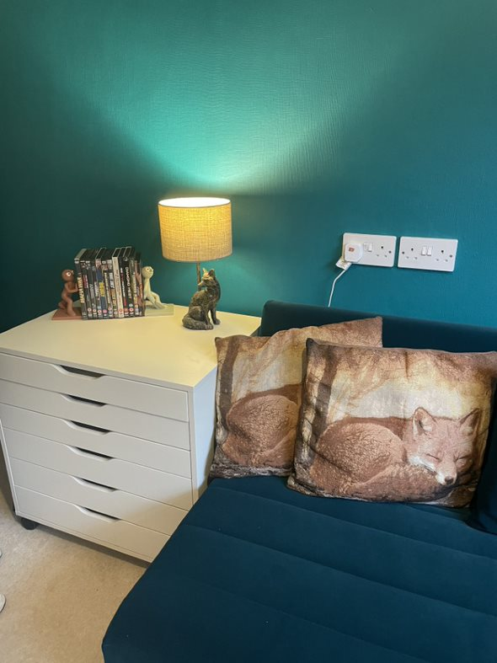
New sofa!

Slide 10
Now to sort through a million DVDs!

Slide 11
Very important picture hanging!

Slide 12
Finishing touches…
games characters!

Slide 13
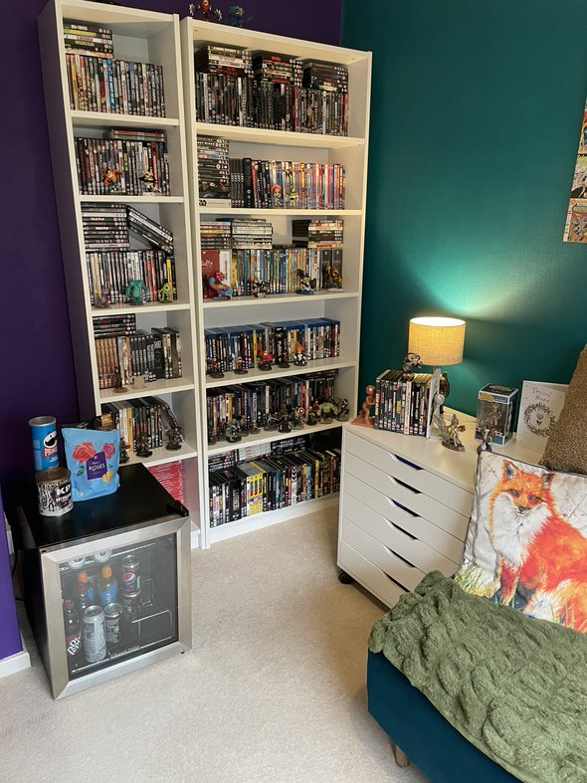
Drinks fridge and snacks ready!

Slide 14
Very important installation!

Slide 15
Game ready!

Slide 16
The Big Reveal!!

Slide 17
Well Done TOM! This is just the beginning!

